Slide 1

Substation and Distribution Automation
Module 5: Substation Automation

Slide 2
Module 5 Overview
Part 1: Introduction to Substations
Part 2: Introduction to Substation Automation
Part 3: Supervisory Control and Data Acquisition (SCADA)
Part 4: Substation Automation and Cyber Security

Slide 3
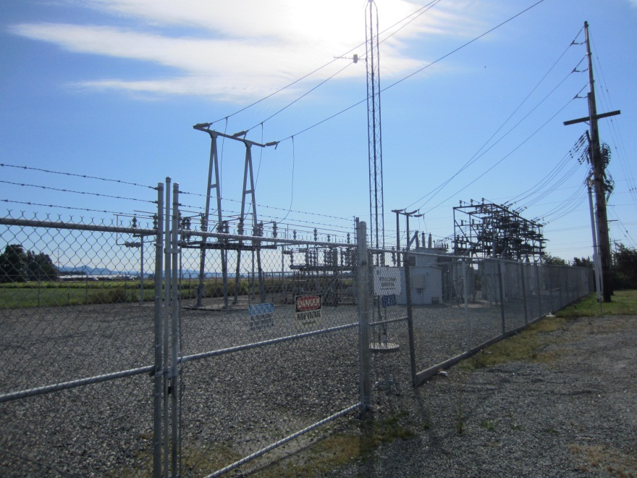
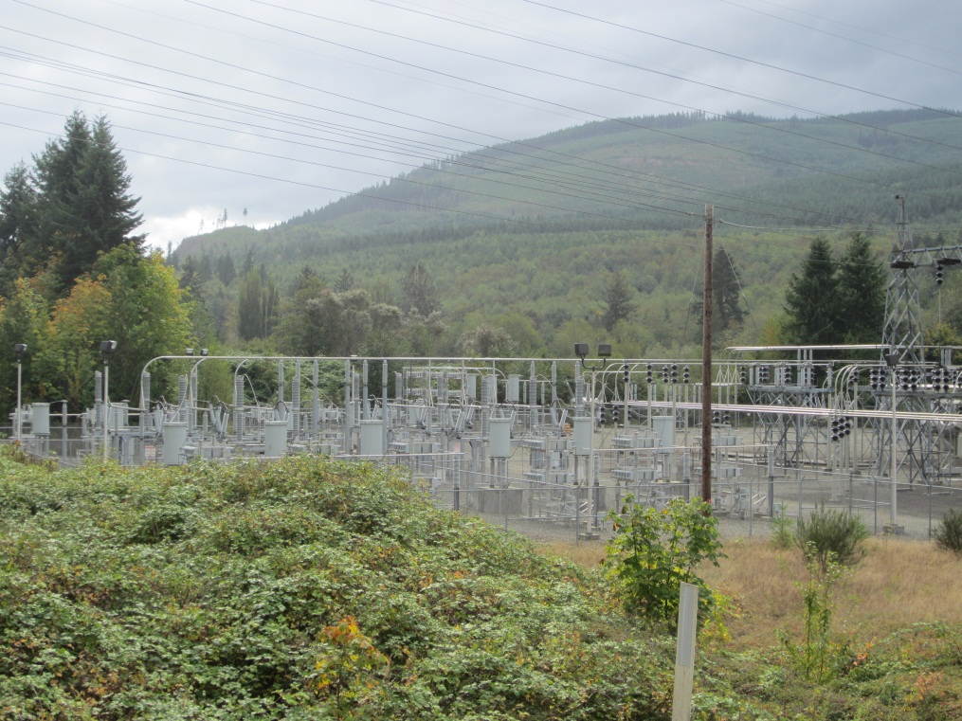
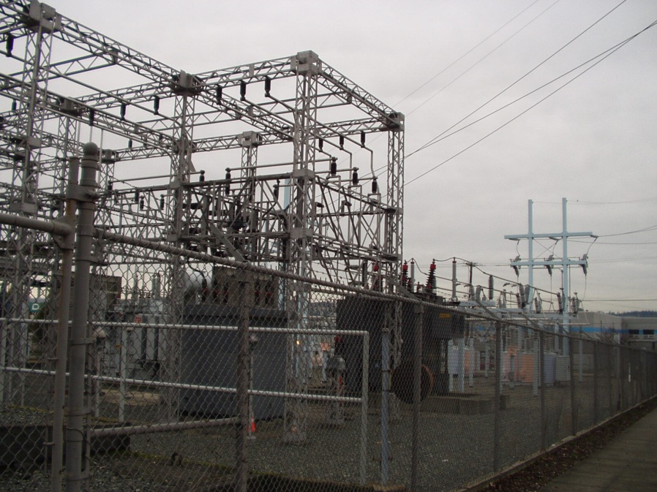
Part 1: Introduction to Substations

Slide 4
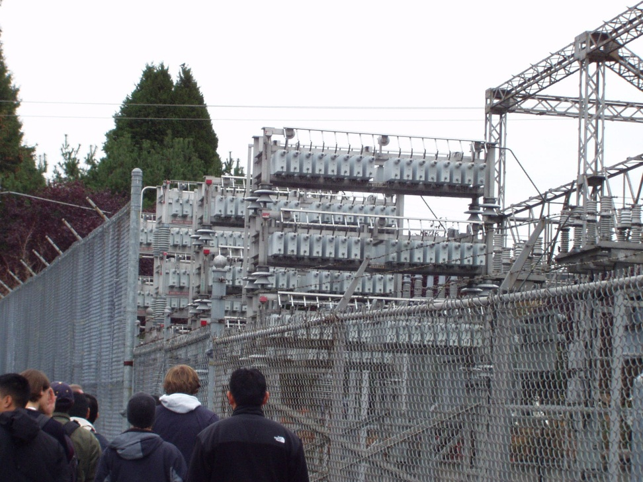
What is a Substation?
Substations are assemblages of electrical components that form important links within the power system.
Electrical power passes through substations for the purpose of switching (connecting and disconnecting components, such as transmission lines), and to transform voltage (from high to low, or the reverse).
Power may go through several substations between generation and consumption, and change voltage in several steps.

Slide 5
Types of Substations
Transmission Substations
Steps up voltage from generation levels to transmission levels for transfer across long distances.
Switching Substations
Operates at a single voltage level (no transformers) and switches operation of power lines.
Distribution Substations
Transfers power from transmission system to distribution system. Steps down voltage to value suitable for local usage.
Combination Substations
Possesses any combination of functionalities defined for the previous three substation types.

Slide 6
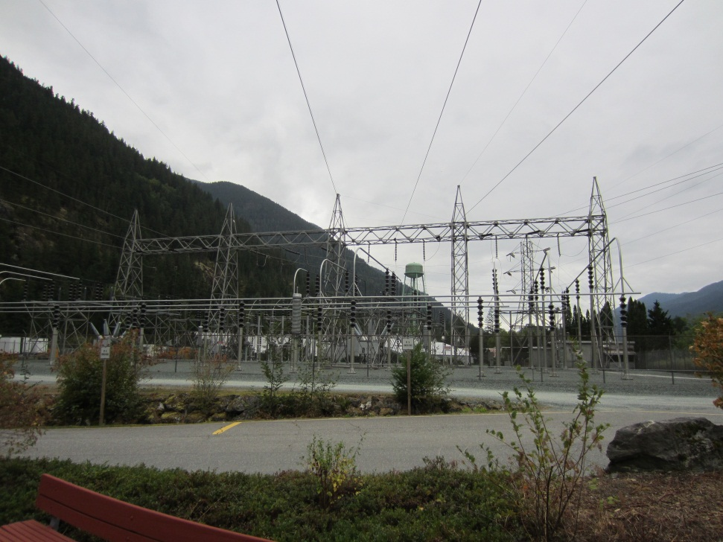
Transmission Substation
Voltage is stepped up from generation levels (3.3,6.6,11.0,33.0kv) to over 50.0kv so that larger amounts of power can be transmitted over large distances
Transmitting at high voltage and lower current minimizes power losses over the distance
Commonly used transmission voltages are 69kv,138kv, 169kv, 230kv, and on large systems 345kv, 500kv, and 765kv.
Uncommon voltages such as 44kv, 115kv, 161kv are also used.

Slide 7
Transmission Substation
Connects generators to transmission or sub-transmission lines.
Disconnect switches on both the source and load sides permit isolation during maintenance or other periods when complete de-energization is required.

Slide 8
Switching Substations
A switching substation is a combination of switching and controlling equipment arranged to provide circuit protection and system switching flexibility.
Operates at a single voltage.
More common on cooperative utilities transmission system.
Helps maintain reliable service under abnormal conditions.

Slide 9
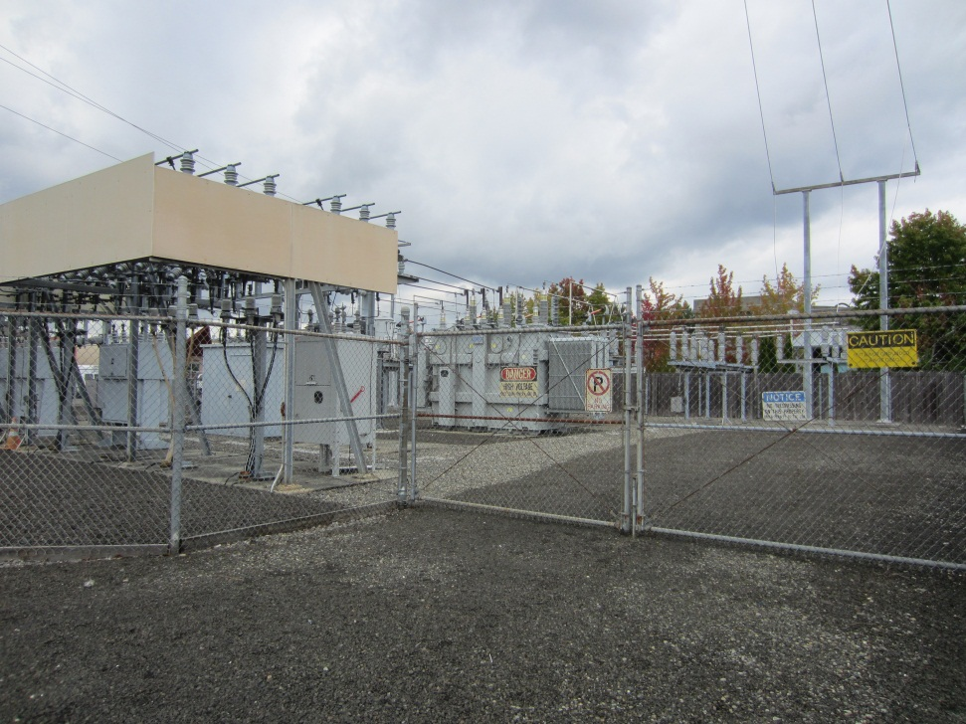
Distribution Substation
Main purpose is to step down the voltage from transmission levels to levels appropriate for local distribution.
May also isolate faults and/or regulate voltage.
Usually characterized by voltages up to 230 kV on the primary side and 12.47LL/7.2LN kV, 13.2LL/7.6LN kV, 13.8LL/8.0LN kV, 24.9LL/14.4LN kV, or 34.5LL/19.9LN kV on the secondary side.
The power transformers commonly used in this application are two-winding type and may be single-phase or three-phase units.

Slide 10
Distribution Substation
The two primary distribution feeders of the substation are protected by either power circuit breakers or automatic circuit reclosers.
Disconnect switches on both the source and load sides permit isolation during maintenance or other periods when complete de-energization is required.
The switches can be either single-pole, single-throw, hook stick-operated or three-pole, single-throw, or group-operated, depending on the arrangement.

Slide 11
Substation Configurations
Various factors affect the reliability of a substation/switchyard, one of which is the arrangement of the buses and switching devices. In addition to reliability, arrangements of the buses/switching device will impact maintenance, protection, initial substation development and cost.
Commonly used substation bus switching configurations include:
Single Bus
Double Bus, Double Breaker
Main and Transfer Bus
Double Bus, Single Breaker
Ring Bus
Breaker-and-a-Half
These schemes can be used for any type of substation.

Slide 12
Single Bus
Involves one main bus, with all circuits connected directly to the bus
Advantages
Simple, low cost, only needs small land area
Disadvantages
Least reliable arrangement
Failure to the main bus or of a circuit breaker causes an outage of the whole system
Connected line must be de-energized to perform maintenance to any device
Maintenance of the bus requires outage of entire system.

Slide 13
Double Breaker, Double Bus
Involves two main buses with two separate breakers for each circuit.
Advantages
High reliability by having two breakers available for each circuit.
Maintenance of bus or circuit breaker may be done without interrupting circuits.
Flexible operating options as additional lines are added
Disadvantages
High-cost because of additional breakers and larger land area requirement– usually only used at large generating stations.

Slide 14
Main and Transfer Bus
Involves two separate and independent buses (main & transfer) with all circuits connected between the two. A bus tie breaker is connected between the buses.
Advantages
Reasonable cost, fairly small land area, easily expandable
If maintenance is required on circuit breaker, circuit can be fed from transfer bus while original breaker is isolated from system.
Disadvantages
Moderate reliability since all circuits connected to the single main bus.
Additional circuit breaker needed for bus tie, complicates protection and relaying
Bus fault causes loss of entire substation.

Slide 15
Double Bus, Single Breaker
Involves two main buses connected to each line circuit and a bus tie breaker– an extension of the single bus configuration.
Advantages
Circuits may be operated from either bus by means of the switches.
In the event of breaker failure (as long as it’s not the bus tie) or bus fault, entire station isn’t shut down.
Disadvantages
Additional circuit breakers needed, thus higher cost.
May cause interruption of non-faulted circuits.

Slide 16
Ring Bus
Involves breakers in a ring with circuits connected in between, creating a closed loop on the bus.
Advantages
High reliability and flexible operation
Circuit or bus failure only affects adjacent breakers, leaving the rest of the system energized.
Maintenance on a circuit breaker may be done without interrupting any circuit, including adjacent ones.
May be developed into a breaker-and-a-half scheme.
Disadvantages
Breaker failure requires adjacent breakers to be tripped to isolate the fault.
Expansion of the ring is limited due to arrangement of circuits.

Slide 17
Breaker-and-a-Half
Involves two buses, and three circuit breakers for every 2 circuits.
Advantages
High reliability, flexible operation, easily expandable.
Any breaker can be removed without outage to any circuit.
Fault on either bus can be isolated without interrupting service.
If center breaker fails, then two adjacent circuits lost, but if outside breaker fails, one circuit lost.
Disadvantages
One-and-a-half breakers needed for each circuit means more cost and more land area needed.
More complicated relaying.

Slide 18
Comparison of Substation Configurations
Configurations | Reliability | Relative Cost | Available Area
Single bus | Least– single failure can cause complete outage | Least– fewer components | Least– fewer components
Main & Transfer Bus | Least– same as Single Bus, but with flexibility in operating and maintenance | Moderate– fewer components | Least– fewer components
Double Bus, Single Breaker | Moderate– Depends on arrangement of bus components | Moderate– more components | Moderate– more components
Ring Bus | High– single failure isolates single component | Moderate– more components | Moderate– increases w/ number of circuits
Breaker-and-a-Half | High– single circuit failure isolates single circuit, bus failures don’t affect circuits | Moderate– 1.5 breakers for each circuit | Moderate– 1.5 breakers for each circuit
Double Bus, Double Breaker | High– single failure normally isolates single component | High– duplicated components | Great– more components per circuit

Slide 19
Multi-Level Substation
Substation can have multiple voltage levels depending on their function.
The most common example of this is the distribution substation where one or more transmission or sub-transmission lines supply the distribution feeders.
Because of the multiple sources, and multiple loads, it is possible to have different schemes on the transmission and distribution side.
For example, the transmission side may uses a double bus double breaker scheme and the distribution side uses break-and-a-half scheme.

Slide 20
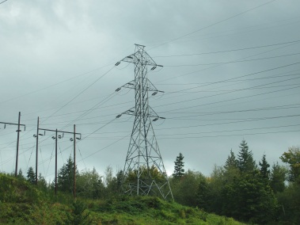
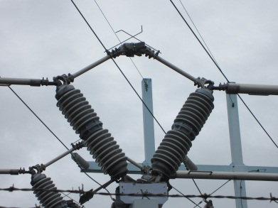
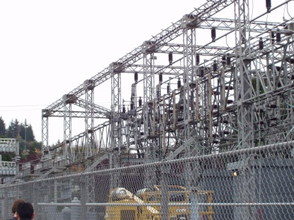
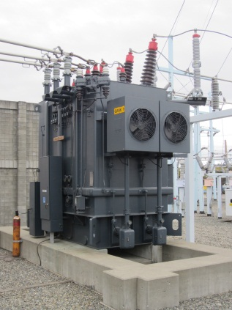
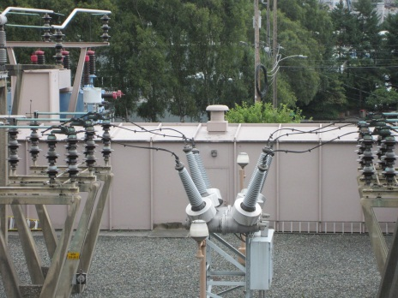
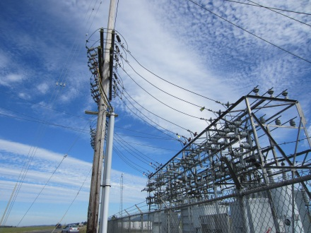
Multi-Level Substation Example

Slide 21
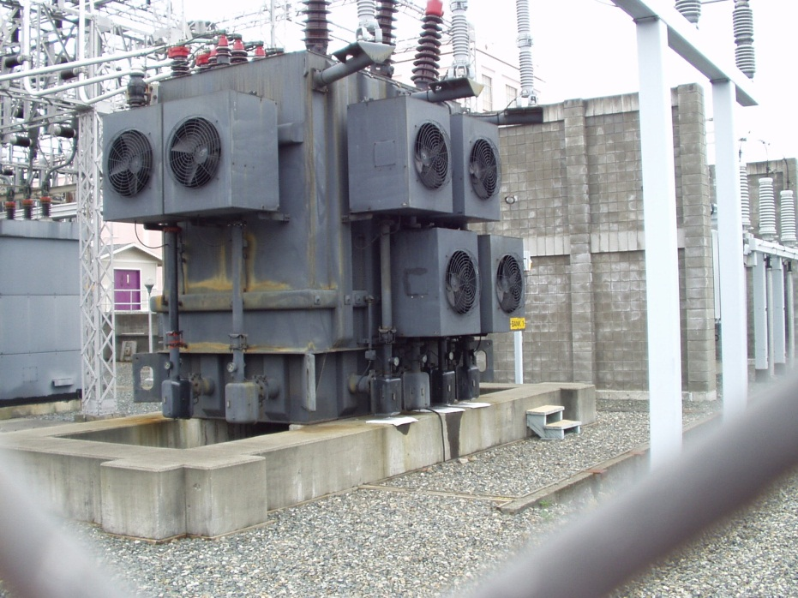

Transmission Substation Devices
Transformer: Steps up voltage from generation levels to levels appropriate for transmission over long distances.
Circuit Breaker: Detects fault condition and interrupts to discontinue electrical flow, thus protecting the electrical circuit. Also used when needed to switch incoming or outgoing transmission circuits.

Slide 22
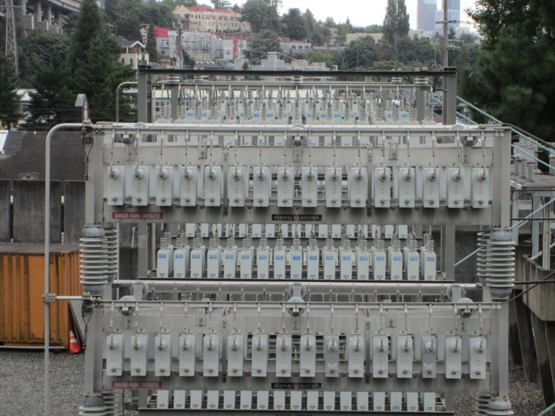
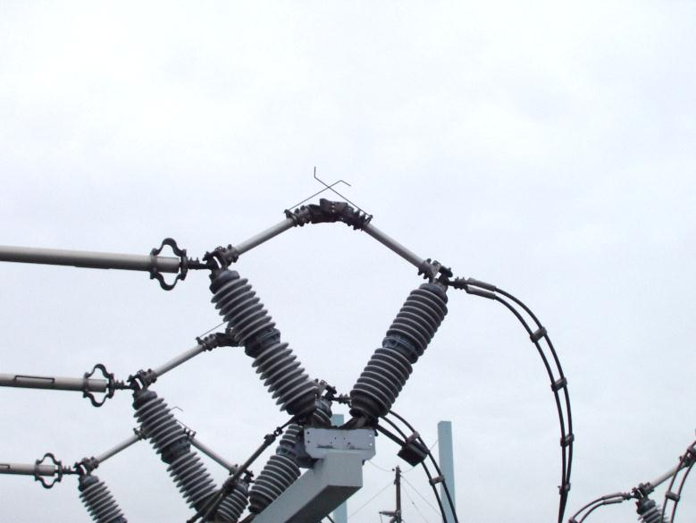
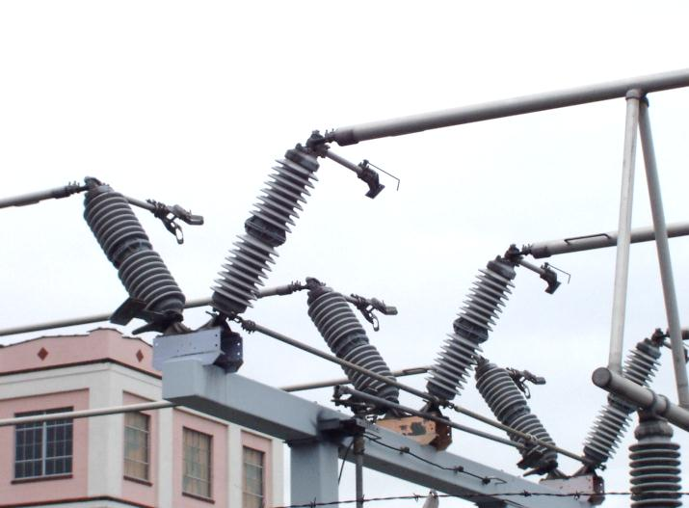
Transmission Substation Devices
Capacitor Banks: Capacitors connected in series or parallel.
Capacitor: Stores electrical charge temporarily to help improve voltage regulation. Consists of two conducting surfaces separated by a nonconductor.
Disconnect switches/grounding switches: Provides isolation from incoming line.

Slide 23
Transmission Substation Devices
Instrument transformers:
When voltage or current is to large to be used by a device, instrument transformers scale it down. They are typically used by measurement, control, and protection devices.
Current Transformer (CT), Potential Transformers (PT) (or, “Voltage Transformer”)
Transducer: Converts one type of energy (electrical, mechanical, electromagnetic, chemical, acoustic, thermal) to another.

Slide 24
Transmission Substation Devices
Carrier equipment:
Line traps: Connected in series with transmission line. Blocks high frequency carrier waves from entering station equipment, and lets power waves pass through.
Capacitance Coupled Voltage Transformer (CCVT): Used in combination with Line traps to filter high frequency communication signals from the power frequency.

Slide 25
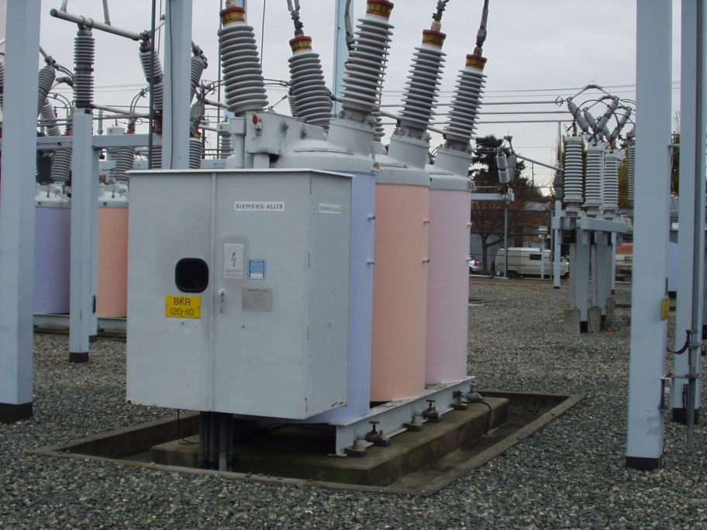
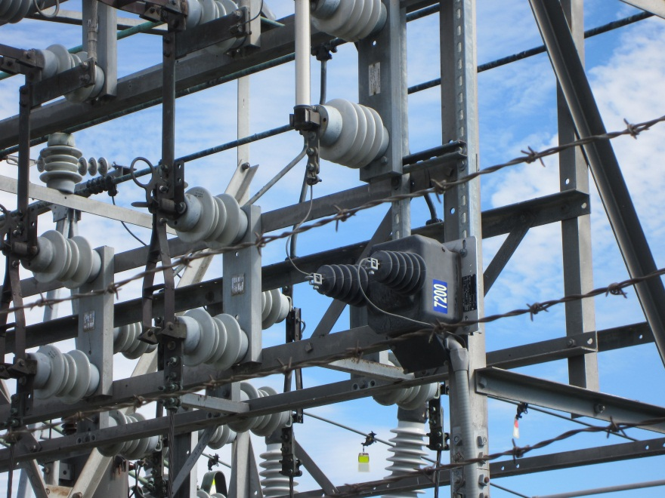
Switching Substation Devices
Circuit Breaker: Detects fault condition and interrupts current to discontinue electrical flow, thus protecting the electrical circuit
Bypass switches: Provides means of taking devices in and out of service without de-energizing feeder circuits.

Slide 26
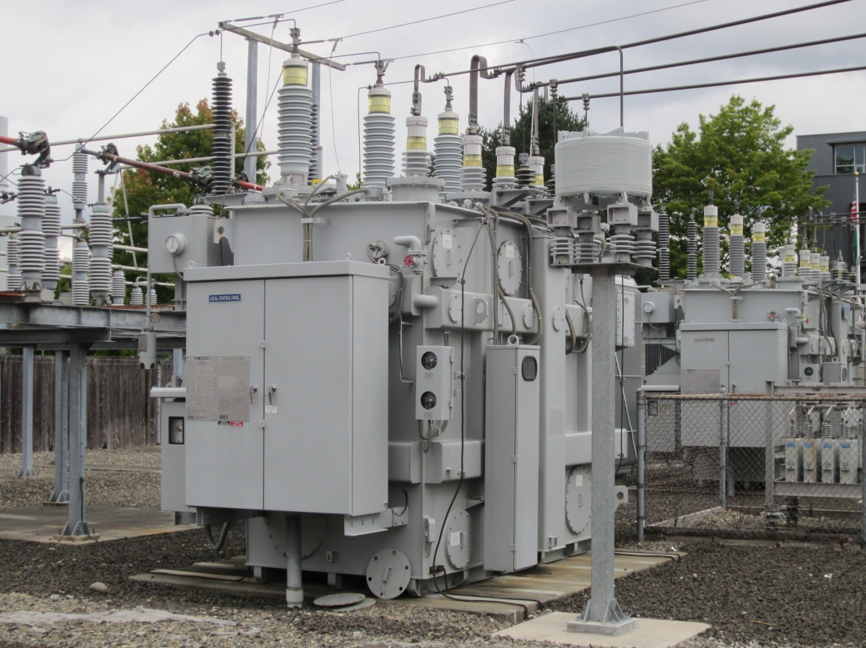
Distribution Substation Devices
Switchgear: Combination of electrical disconnects, fuses, and circuit breakers used to isolate equipment. Used to de-energize equipment either for maintenance or to clear faults.
Transformer: Steps down voltage to level appropriate for distribution.
Transformer protection devices:
Fuses: Stop the flow of current in the case of an internal fault or transformer short-circuit.
Circuit breakers: Interrupt current

Slide 27
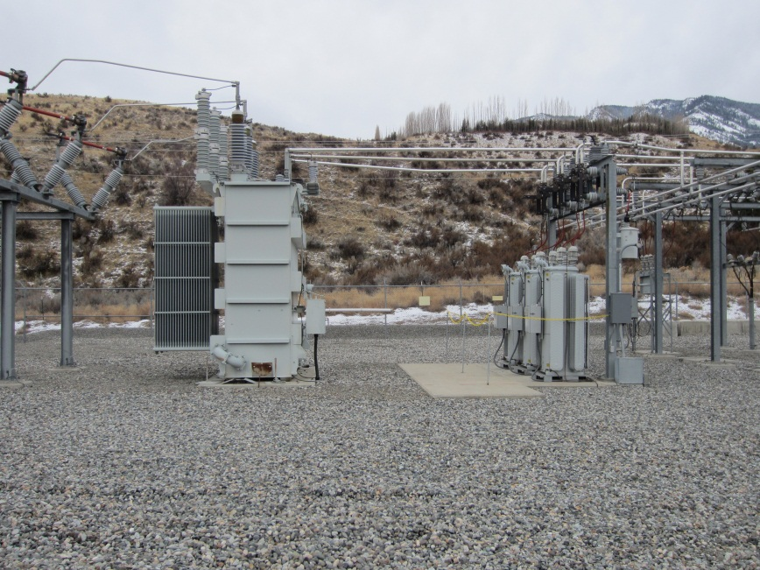

Distribution Substation Devices
Voltage regulator: Raises or lowers distribution voltage to provide as close to constant voltage as possible.
Bypass switches: Provides means of taking devices in and out of service without de-energizing feeder circuits.

Slide 28
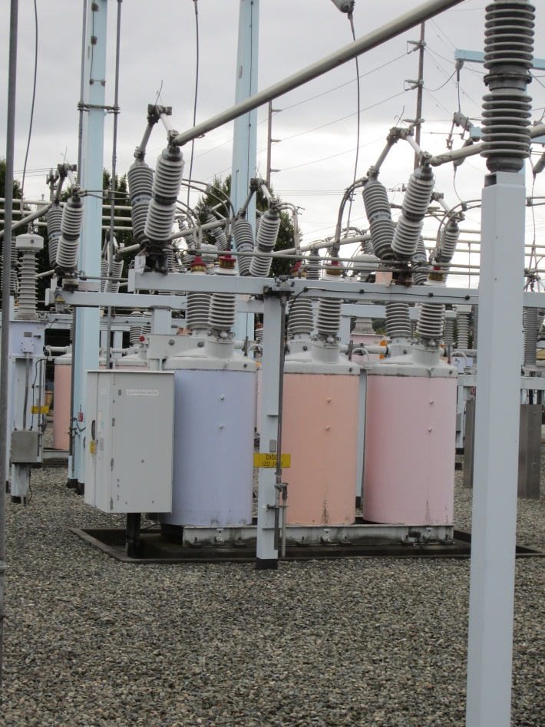
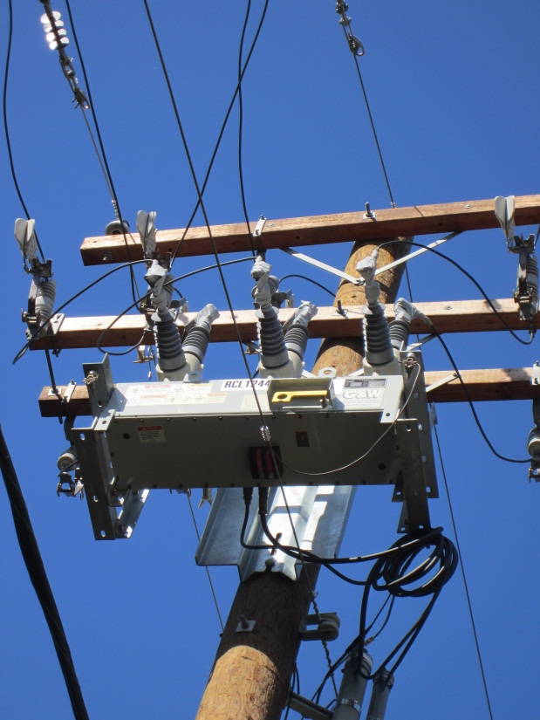
Distribution Substation Devices
Circuit Breaker/ Recloser Bypass facilities: Able to interrupt fault current and disconnect faults from the system.
Reclosers: Can automatically restore a circuit when power is lost due to a temporary fault.

Slide 29
Distribution Substation Devices
Surge Arrestors: Protect substation from voltage surges (i.e., Damage during lightning storms), can be installed on power poles, towers, transformers, or circuit breakers, and diverts surges to the ground.
Shunt Capacitor Banks: Capacitors connected in parallel with lines. Supply reactive power to counteract the current being out-of-phase with voltage, which is introduced by inductive loads.

Slide 30
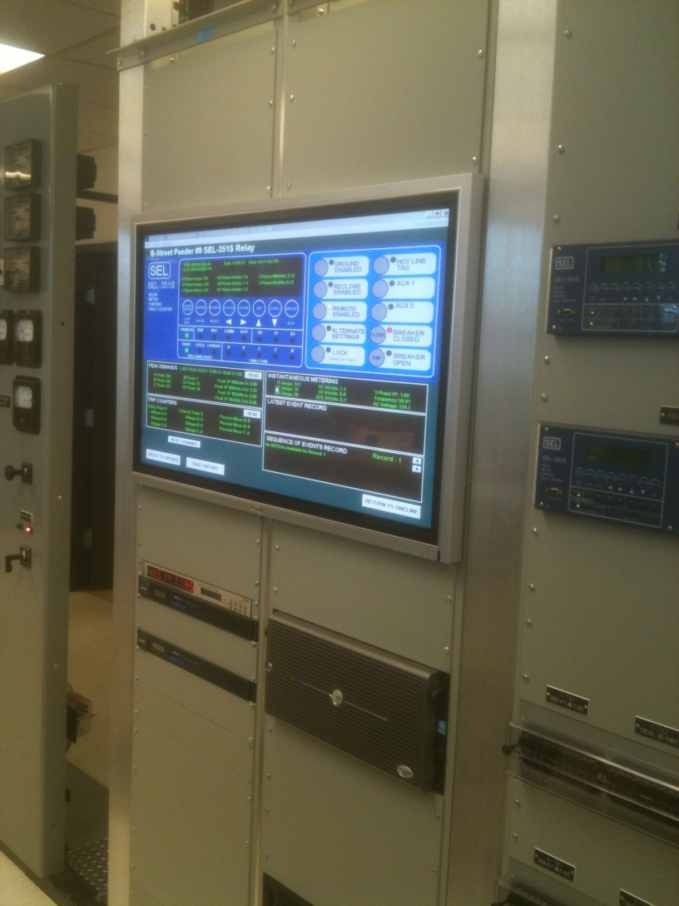
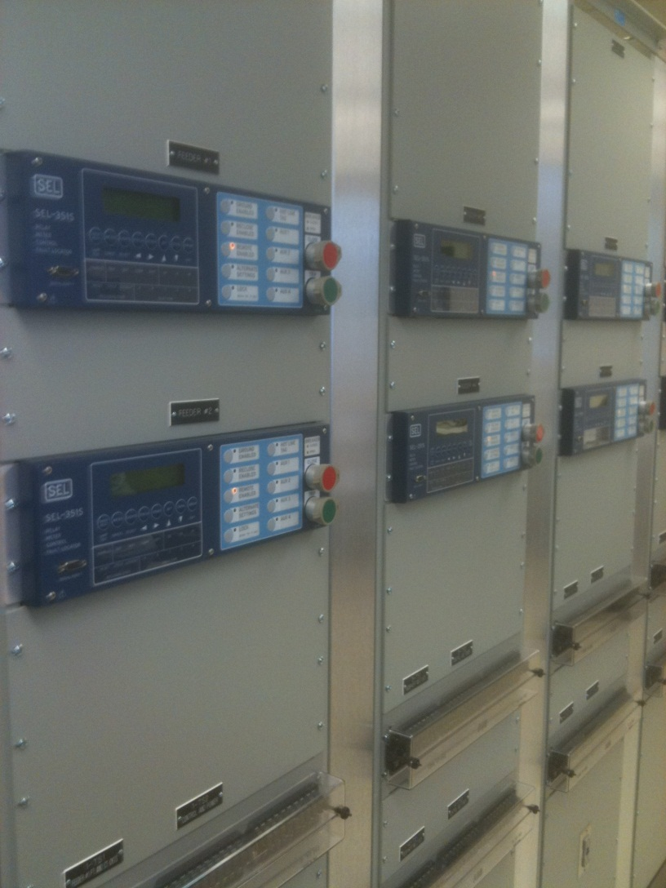
Part 2: Introduction to Substation Automation

Slide 31
What is Substation Automation?
Substation automation (SA) is the use of computers, communications, and networking equipment to optimize substation operations and to facilitate remote monitoring and control of substations cost-effectively.
Substation automation uses intelligent electronic devices (IEDs) in the substation to provide enhanced integrated and coordinated monitoring and control capabilities.
Substation automation may include traditional supervisory control and data acquisition (SCADA) equipment, but more often encompasses traditional SCADA functionality while providing extended monitoring and control capabilities through the use of non-traditional system elements.

Slide 32
Automation and Substation
Substation Automation is dependent on the interface between the substation and its associated equipment.
It is necessary to have standard interface to all IED’s in a substation such that the communication capabilities of each may be merged.
Interface should also serve the needs of corporate users to a level to justify its existence.
Five Levels of Substation Integration and Automation:
Utility Enterprise
Substation Automation Applications
IED Integration
IED implementation
Power System Equipment (transformers, breakers, …etc.)

Slide 33
New Versus Existing Substations
New Substations
IEDs With Digital Communications
Programmable Logic Controllers (PLCs) for Direct I/O
No Conventional Remote Terminal Units (RTUs)
Existing Substations
May Integrate IEDs With Existing RTUs (Not Support Non-Operational and Remote Access Data Paths)
Integrate Existing RTU as IED or Eliminate Existing RTU and Use IEDs and PLCs for RTU I/O

Slide 34
Communication Networks
The interface between the physical substation components and the virtual “automation” relies upon the communication infrastructure.
There are multiple network types that have been used, each with its own advantages and disadvantages.
Some of the more common network types include:
Wire line networks
Optical fiber networks
Wireless networks
Satellite networks
Hybrid networks

Slide 35
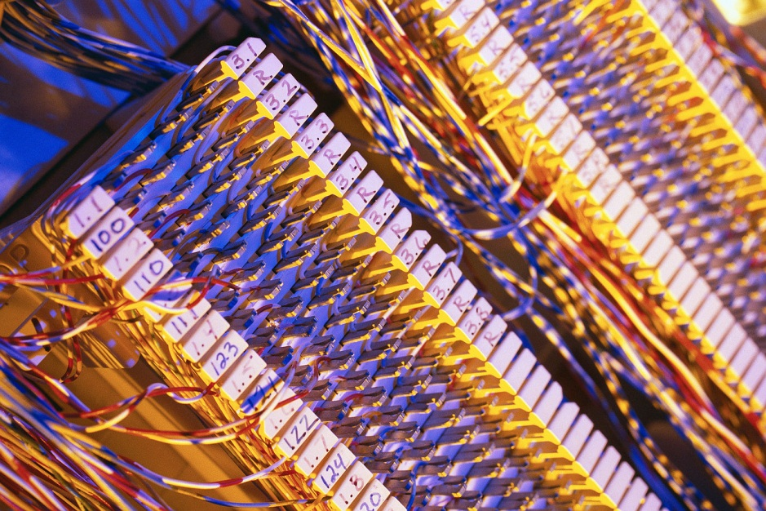
Wire Line Networks
Networks in which the medium of data transmission is physical ‘wire’.
A wire line network can have a number of topological structures. Some of these include:
Point to point networks: dedicated link between two endpoints
Point to multipoint networks: link between one point and many on the other end.
Peer to peer networks: Any network node may share with any other node
Advantages: There is a great deal of wire infrastructure already in place in many areas.
Disadvantages: Limited flexibility with topologies, and limited speed.

Slide 36
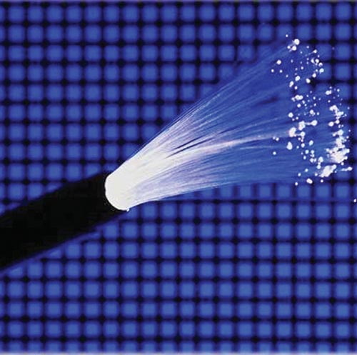
Optical Fiber Networks
Networks in which information is transferred via optical fibers.
First developed by Corning Glass Company in 1970.
By the end of the 1970’s the phone company was operating the first optical link on their system.
Advantages: High capacity, immunity to Electro Magnetic Interference/ Radio Frequency Interference.
Disadvantages: Higher cost

Slide 37
Wireless Networks
Networks in which information is transferred via radio frequencies.
Wireless networks can be desirable for remote substation locations where there is no wire or fiber already in place.
Advantages: Relatively fast installation, lower cost (savings in cable costs).
Disadvantages: Security concerns, bandwidth capacity limitations.

Slide 38
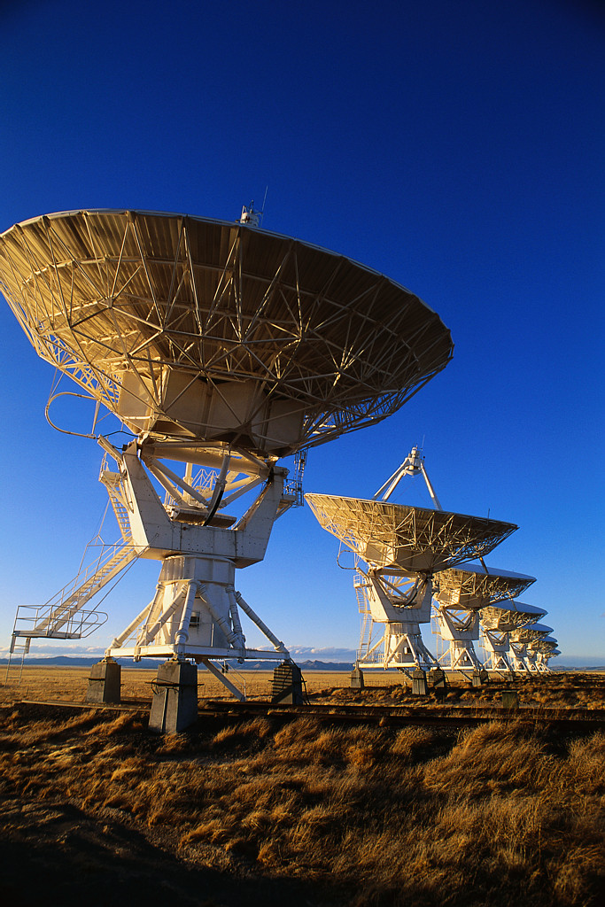
Satellite Networks
Networks in which information is transferred via satellites.
Satellite communications can be established anywhere on the plant.
Advantages: Good for areas where other communication infrastructure may not exist, High Bandwidth.
Drawbacks: Long Delay (Comparatively higher than wired networks), Channel characteristics (Performance affected by weather or effect of fading).

Slide 39
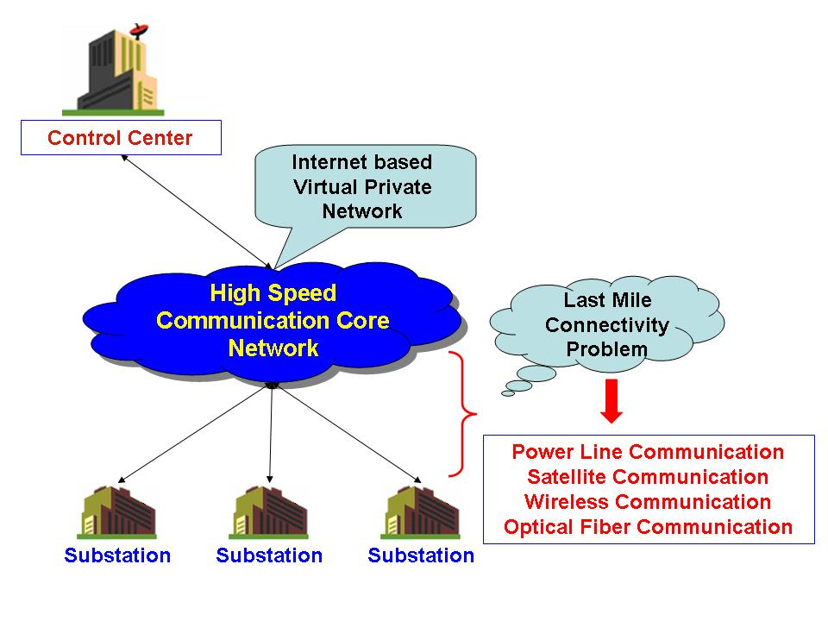
Hybrid Networks
Networks in which information is transferred via multiple network types.
High speed communication core network (internet based VPN)
Connection of rural substations to the high speed communication network via other means.
Power Line
Satellite
Wireless
Optical fiber

Slide 40
Communication Network Requirements
Regardless of the type, communication networks need to be:
High bandwidth (lots of data–& increasing in future), real-time monitoring
Reliable (objective of no losses, deal with failure well)
Scalable (allow for additional substations)
Robust (performance doesn’t deteriorate under changing network traffic)
Secure (safe from external attacks, both physical and cyber)
Internet Virtual Private Network (VPN) technologies allows minimum cost, highly reliable information sharing
Good for substations in urban areas, but more difficult for rural substations where internet may not exist

Slide 41
Functional Diagram of Substation Automation System
1
2
3

Slide 42
Substation Automation Functional Architecture
SCADA system
Data Warehouse (Data Concentrator, SCADA interface, Router)
Three primary functional data paths:
Operational data (instantaneous values of power system analog and status points– volts, circuit breaker status, …etc. ) to the SCADA system. This allows utility’s dispatchers to monitor and control power system
Non-operational data(event summaries, records, …etc. ) to data warehouse. This is the most challenging path due to characteristics and on-demand nature of data
Remote access to IED

Slide 43
Substation Automation System Responsibilities
The system must interface with all of the IEDs in the substation.
The data from all the IEDs must be sent to the utility enterprise system to populate the data warehouse or be sent to an appropriate location for storage.
The system must isolate supplier proprietary functionality by providing a generic interface to the IEDs.
The system should be updated with a report-by-exception scheme, where status-point changes and analog-point changes are reported only when they exceed their significant dead band.
The types of data and control that the system will be expected to facilitate are dependent on the choice of IEDs and devices in the system.
This must be addressed on a substation-by-substation basis. The primary requirement is that the analog readings be obtained in a way that provides an accurate representation of their values.

Slide 44
Level 1 Field Devices
Each electronic device (relay, meter, PLC, etc.) has internal memory to store some or all of the following data: analog values, status changes, sequence of events, and power quality.
These data are typically stored in a FIFO (first in, first out) queue and vary in the number of events, etc., maintained.

Slide 45
Level 2 Substation Data Concentrator
The substation data concentrator should poll each device for analog values and status changes at data collection rates consistent with the utility’s SCADA system.
For example it should collect status points every 2 sec, tie-line and generator analogs every 2 sec, and remaining analog values every 2 to 10 sec.
The substation data concentrator should maintain a local database.

Slide 46
Level 3 SCADA
All data required for operational purposes should be communicated to the SCADA system via a communication link from the data concentrator.
All data required for non-operational purposes should be communicated to the data warehouse via a communication link from the data concentrator.
A data warehouse is necessary to support a mainframe or client-server architecture of data exchange between the system and corporate users over the corporate WAN (wide area network).

Slide 47
Substation Host Processor
The substation host processor should be based on industry standards and strong networking ability, such as Ethernet, TCP/IP, UNIX, Windows 2000 or XP, Linux, etc.
It should also support an open architecture, with no proprietary interfaces or products.
An industry-accepted relational database (RDB) with structured query language (SQL) capability and enterprise-wide computing should be supported.

Slide 48
Substation LAN
The substation LAN should meet industry standards to allow interoperability and the use of plug-and-play devices.
Open-architecture principles should be followed, including the use of industry standard protocols (e.g., IEEE 802.x (Ethernet)).

Slide 49
Part 3: Supervisory Control and Data Acquisition (SCADA)

Slide 50
Supervisory Control and Data Acquisition (SCADA)
In order for a substation automation scheme to be effective there must be an operational communications systems over which data can be transmitted, and over which control signals can be passed.
For electric power systems SCADA is the system that is responsible for the acquisition of data and the transmission of control signals.
The specific implementation of a SCADA system will vary depending on the specific communication medium, or mediums, and the operating protocol.

Slide 51
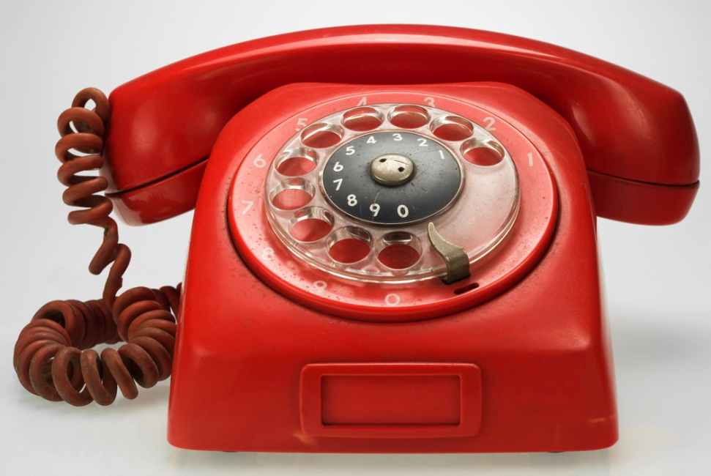
SCADA Transport Medium
Advanced Radio Data Information Service (ARDIS)
Plain Old Telephone System (POTS)
Wireless Telephone Service
Cellular Digital Packet Data (CDPD)
Telephone Lines : leased and dial-up
Private Microwave Radio
Multiple Address Systems (MAS)
Very Small Aperture Terminal Satellite (VSAT)
Land-Mobile Two-Way Radio
Optical Fiber
Power-Line Carrier (PLC)
Short Message System (SMS)

Slide 52
Advanced Radio Data Information Service (ARDIS)
Originally developed jointly by Motorola and IBM in early 1980’s.
ARDIS is optimized for short message applications that are relatively insensitive to the transmission delay.
ARDIS uses connection oriented protocols well suited for host/terminal applications.
As a radio based service, ARDIS can be expected to be immune to most of the Electromagnetic Compatibility (EMC) issues associated with substations.
Provides 4800 bps or 19.2 kbps service using 25 kHz channel in the 800 MHz band.

Slide 53
Plain Old Telephone Service (POTS)
Standard 2-wire analog telephone lines are known as plain old telephone service (POTS) in the telecommunication industry.
Probably the most economical way to communicate with remote locations in situations where only occasional data transfer is required.
Installation of a dial-up modem is very straight forward and there are plenty of off-the shelf components are available, giving users plenty of options.
Not suitable for transferring large amounts of data since the data rates for modems are limited to 33kbps and below.
GPR concerns can limit the POTS use.

Slide 54
Wireless Telephone Service
Wireless telephone service is useful where GPR concerns prevent the installation prevent the installation of POTS line.
The biggest difference will be a degradation in performance when compared to POTS since the bandwidth available on a cellular or PCS connection will limit data rates to a maximum of 14.4 kbps.
Wireless service is generally priced on flat rate basis with per minute charges.
Packages that include a large number of minutes per month can make cellular access to a substation affordable, especially when a connection is only needed a few times per week or less.

Slide 55
Cellular Digital Packet Data (CDPD)
In addition to regular wireless telephone service, some cellular service providers offer a service known as CDPD.
CDPD is internet based technology (TCP/IP) that allows the transmission of data on idle cellular channels.
Requires the use of special CDPD radios.
The service is best suited for applications that send bursts of data on an occasional basis, as it is priced on a per-kilobyte basis.
CDPD is generally only available in large metropolitan areas and in most cases only offered by a single wireless service provider in a given area which limits competition and keeps the prices high.

Slide 56
Telephone Lines: leased and dial-up
Useful where POTS line is acceptable but continuous access to the substation is desired.
Dedicated lines or leased private voice–grade lines with standard 3-kHz voice bandwidth that can be provided by telephone company.
There are some security issues for all telephone circuits in that they can be easily tapped in an obtrusive manner which makes them vulnerable to security attacks.
Some security measures can be enabled such as sign-on passwords with a dial-back modem or physical layer encryption.

Slide 57
Private Microwave Radio
Some utilities have built their own networks by utilizing a high-capacity microwave radio system. These systems are owned and operated by the utility.
Depending on the radio types used, data can be transmit anywhere from 1.5 Mbps (24 voice channels) to hundreds of Mbps (thousands of voice channels).
The cost of ownership of a microwave system, however, can be quite high.
Microwave radios require line-of-site transmission and therefore often require tall (100-300 ft.) towers to allow for effective communication.

Slide 58
Multiple Address Systems (MAS)
Multiple Address Systems (MAS) are 900 MHz radio systems designed for SCADA applications.
They operate in a point-to-multipoint mode where a “master” radio station polls “slave” radios located at the substations.
MAS stations typically operate at 9.6 kbps and do not require twisted pair circuits in the substation.
Slow MAS speed limits the number of polls that can be performed per minute, meaning a utility must limit the number of substations its serving with a single MAS.
MAS is a popular communication system used by utilities for SCADA and Distribution Automation (DA) systems.

Slide 59
Very Small Aperture Terminal Satellite (VSAT)
VSAT services are specifically tailored towards SCADA applications.
These services utilize a dish approximately 18-24 inches in diameter and are offered by service providers who handle issues such as collection of data and leasing of satellite time.
VSAT systems are especially suited for remote locations that would require expensive leased lines or are otherwise unreachable.
VSAT service providers generally charge a per month charge in the range one or two hundred dollars per month with a per-Mb charge for the data.

Slide 60
Land-Mobile Two-Way Radio
For applications that transmit small amounts of data, traditional two-way radio systems may be able to support communication.
Applications suited for two-way radio include report-by-exception alarms (i.e., simple contact closures) or simple telemetry such as the report of a river level every minute or two.
The biggest drawback to two-way radio is its relatively low speed and short range.
Data rates are usually 9.6 kbps or less, although some dedicated links can run as fast as 19.2 kbps.
Two-way radio is usually considered when a low cost solution is needed for transmitting low-speed data a short distance (10 miles or less).

Slide 61
Optical Fiber
This is the most versatile technology for substation communication.
Optical fiber have the capability of operating at extremely high data rates.
A wide variety of applications (not only telecommunications but also protective relaying and measurement systems) have been adapted to work over optical media.
Optical Fiber does not conduct electricity and hence its very safe from GPR perspective.
Fiber optic systems can be obtained that can transfer data anywhere from 1.5 Mbps (24 voice channels) to almost 10 Gbps (well over 100,000 voice channels).
The fiber optic cable itself is quite expensive to install but the enormous capacity makes it possible for utilities to share capacity with outside parties, which helps recover the cost of installation.

Slide 62
Power-Line Carrier (PLC)
PLC systems operating on a narrow channels between 30 and 500kHz are frequently used for high-voltage line protective relaying applications.
Typically one station sends a signal to trip a relay in another station by using simple one-bit messages using either an amplitude or frequency shift keying.
Some PLC systems have also been developed for specialized distribution feeder applications such as remote meter reading and distribution automation.
The TWACS (Two-Way Automatic Communication System) is one such PLC system used for both meter reading and distribution automation.

Slide 63
Short Message System (SMS)
Also known as text messaging, uses forward and reverse control channels of cell phone systems to provide two-way communication for very short telemetry messages.
Well suited for control and status messaging from simple RTUs.
Utility interface to the system is provided using internet, telephone, and pager services.

Slide 64
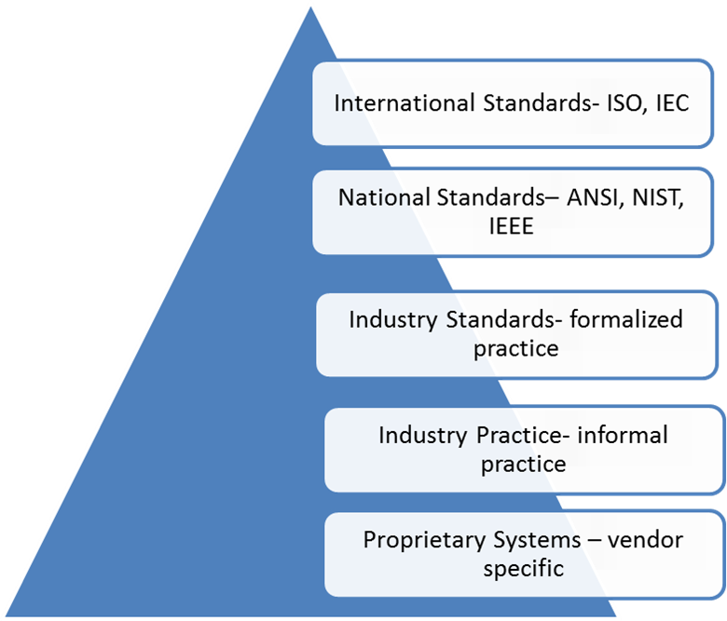
SCADA Communication Protocols
DNP3
IEC 870-5
UCA 1.0
ICCP
UCA 2.0
IEC 61850
ARDIS

Slide 65
DNP3
Also known as Distributed Network Protocol, the DNP protocol was developed for communication with tele-control substations and other intelligent electronic devices (IEDs).
Developed by GE Harris, it is based on earlier parts of IEC 870-5.
Originally, the protocol's main use was for slow serial communication, its present-day version also supports TCP/IP-based operation.
DNP 3.0 commands a very powerful application layer, which allows the decoding of data without the use of implicit parameters.
This is the dominant application in North America and industrialized Southern Hemisphere Countries.

Slide 66
IEC 870-5
Provides similar application facility as DNP.
Developed by technical committee 57 working group 03 chartered to develop this standard.
Primarily designed for point-to point or multi-drop serial link architectures but can also work over radio, LAN, etc.
Unlike DNP, IEC 870-5 has no transport layer. Each data link frame containing application data is a complete application message.
This is the dominant application in Europe and Middle East.

Slide 67
UCA 1.0
Also known as Utility Communication Architecture 1.0.
By the early 1980’s there was interest in the development of an open source SCADA protocol.
UCA 1.0 arose from the need for common communication across the utility enterprise.
The Electric Power Research Institute (EPRI) published the initial results from the development of UCA 1.0 in 1991.
The UCA 1.0 specification outlines a communication architecture based on existing international standards.
It specifies the use of manufacturing message specification (MMS: ISO 19506) in the application layer for substation communication.

Slide 68
ICCP
Also called as inter-control center communications protocol or IEC 60870-6 Tele control Application Service Element 2 (TASE.2) protocol.
ICCP grew out of the work of UCA 1.0.
Developed by IEC TC57 WG07 for data exchange over Wide Area Networks (WANs) between a utility control center and other control centers, other utilities, power plants and substations.
ICCP is used in almost every utility for inter-control center communications between SCADA and/or EMS systems. It is supported by most vendors of SCADA and EMS systems.

Slide 69
UCA 2.0
UCA 2.0 is a next generation of UCA protocols and is a combination of ICCP protocols and Generic Object Models for Substation and feeder Equipment (GOMSFE) specification.
IEC 61850 has evolved from UCA 2.0 version.

Slide 70
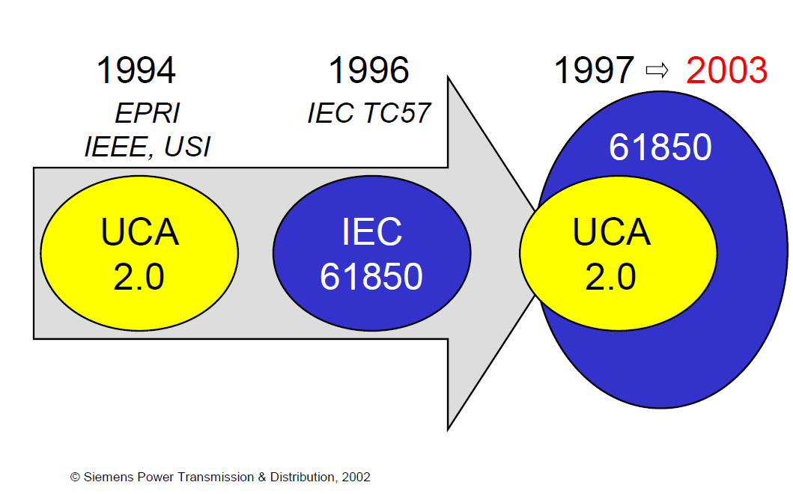
UCA and IEC 61850
Diagram shows the timeline and relation between UCA and IEC 61850 protocols

Slide 71
IEC 61850
The IEC 61850 standard is the first of an emerging approach to networkable, object-oriented SCADA protocols based on work started in the mid-1980’s by the Electric Power Research Institute (EPRI) which became known as UCA.
IEC 61850 is a superset of UCA 2.0, i.e., it contains almost all the UCA 2.0 specification and many other additional features.
IEC 61850 will provide interoperability between the IEDs for protection, control, monitoring, and automation in substations.
Chief advantages of IEC 61850 are:
Simple substation structure: No more interface problems. With IEC 61850, protocol diversity and integration problems are no more a problem.
Everything is simpler: Save time and costs on configuration, commissioning and maintenance.
Reduction of costs: IEC 61850 replaces wiring between feeders, control switches, and signaling devices.
More reliability: You only use one communication channel for all data – in real time, synchronized via Ethernet.

Slide 72
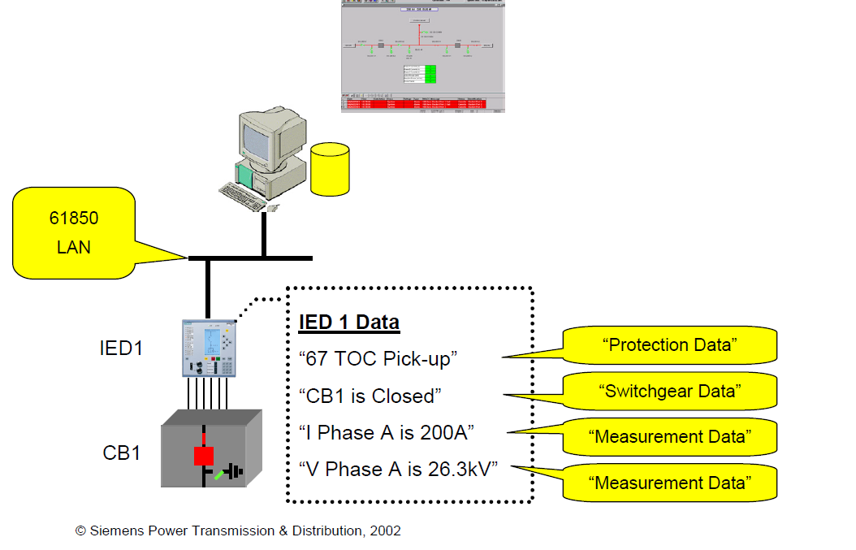
Data Communications using 61850
Instead of dividing data into I/O types likes digital input data, analog input data, etc as is the case with DNP 3.0 , IEC 61850 divides the data into logical groupings such as protection data, switchgear data (shown in picture above)

Slide 73
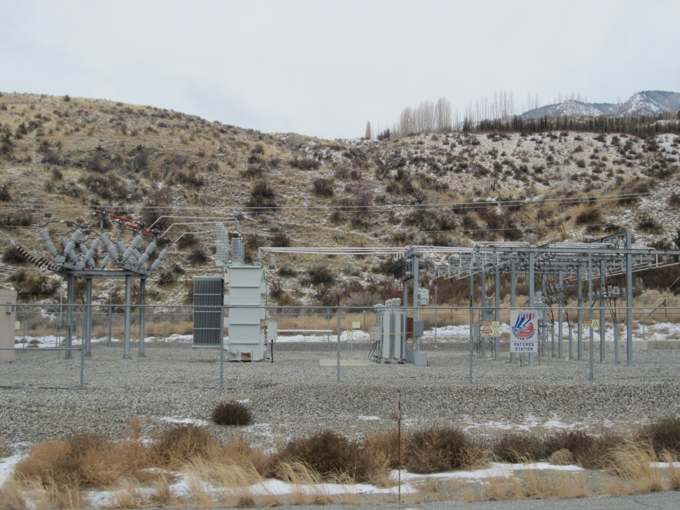
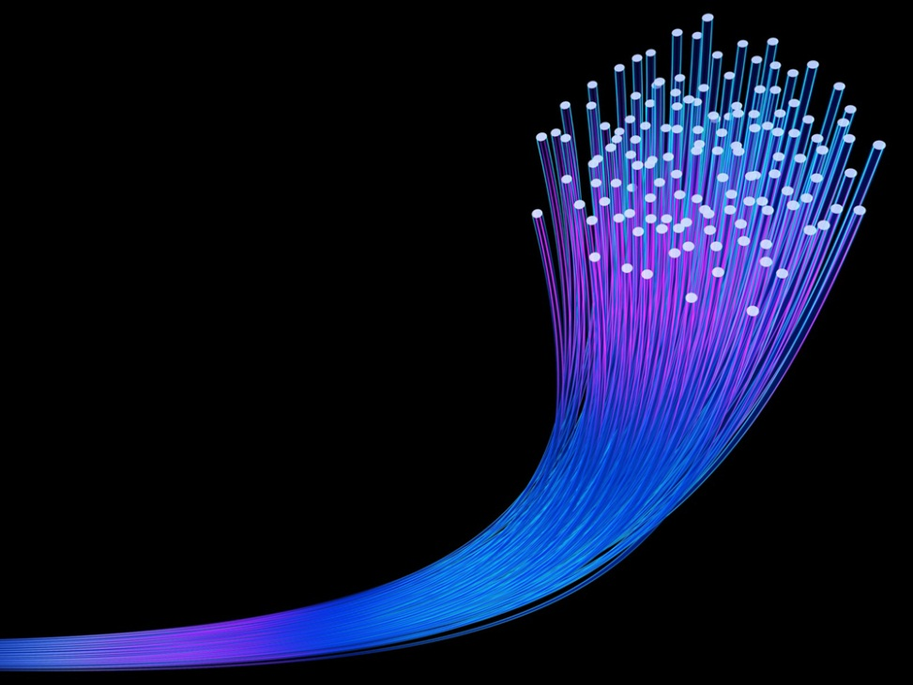
Part 4: Substation Automation and Cyber Security

Slide 74
Cyber Security Terminology
Cyber Security: Security from threats conveyed by computer or computer terminals, also the protection of other physical assets from modification or damage from accidental or malicious misuse of computer based control facilities.
Firewall: A device that implements security policies to keep a network safe from unwanted data traffic
Protocol: A formal set of conventions governing the relative timing of message exchange between two communication terminals.
Password: A password is a sequence of characters that one must input to gain access to a file, application or computer system.
Remote access: Access to the control system or IED by a user whose operation terminal is not directly connected to the control system or IED.

Slide 75
General Cyber Security Concerns
Relay Settings : They are often accessed by protection engineers to update and change the settings values.
Insecure communications media: The data messages that substation IEDs exchange with the outside world are often transmitted over media that are potentially open to eavesdropping or active intrusion.
Open Protocols: The communication protocols most frequently used in substations are very well known.
Lack of authentication: Communication protocols in current use do not provide a secure means for systems that exchange data to authenticate each other’s identity.

Slide 76
Module 5 Concluding Comments
Substations are critical components of the modern power system that allow for the interconnection of generation, the switching of transmission lines, and the changing of voltage levels.
The electrical buses in a substation can be interconnected through a number of standard configurations.
While every substation will be slightly different, there are a number of pieces of equipment that are common to all.
Substation automation (SA) is the use of computers, communications, and networking equipment to optimize substation operations and to facilitate remote monitoring and control of substations in a cost-effective manner.
Communication medium
Communication protocols

Slide 77
Substation and Distribution Automation
Conclusion of Module 5: Substation Automation

